Slide 2
Question and Hypotheses
Question: Do the number of electric vehicle chargers and state incentives in a state affect the rate at which electric vehicles are utilized?
Hypothesis: States with a higher number of electric vehicle chargers and state incentives for purchasing electric vehicles will show a higher number of registered electric vehicles per capita.
Null hypothesis: States with a higher number of electric vehicle chargers and state incentives for purchasing electric vehicles will not show a higher number of registered electric vehicles per capita.

Slide 3
Data Sources
EV Charger and State Incentives: National Renewable Energy Laboratory API
EV Registration Numbers: Alternative Fuels Data Center
State Population: US Census estimate for 2022
% of State Population in Urban Area: Iowa State University Iowa Community Indicators Program

Slide 4
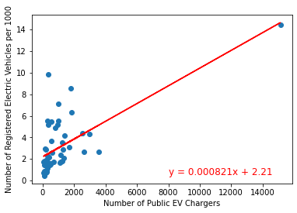
Registered EVs per 1000 by Number of Public Chargers
r-squared: 0.45
Correlation between both factors: 0.67

Slide 5
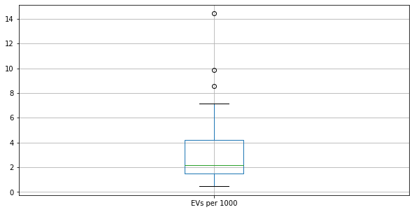
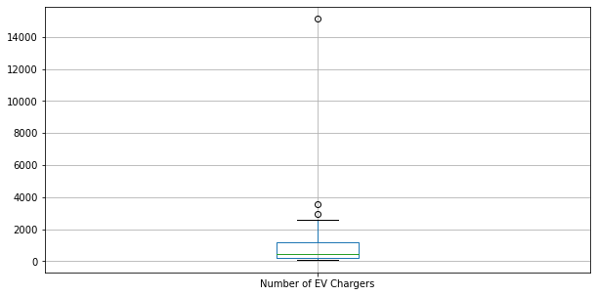
EV Charging Station Outliers

Slide 6
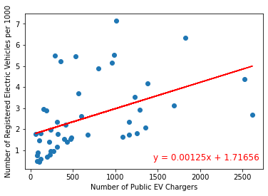
Registered EVs per 1000 by Number of Public Chargers (Outliers Removed)
r-squared: 0.21
Correlation between both factors: 0.46

Slide 7
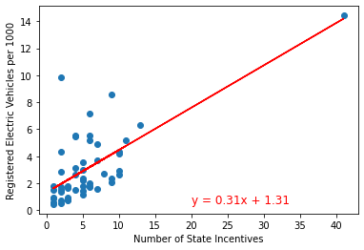
Registered EVs per Capita by Number of State Incentives
r-squared: 0.49
Correlation between both factors: 0.70

Slide 8
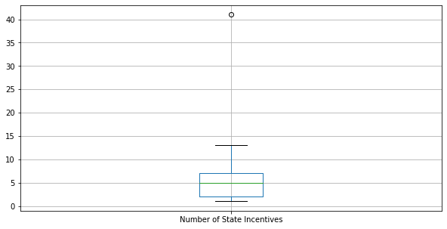
State Incentive Outliers

Slide 9
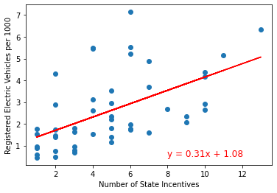
Registered EVs per Capita by Number of State Incentives
r-squared: 0.30
Correlation between both factors: 0.55

Slide 10
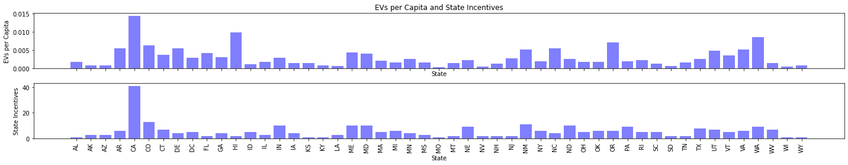
Exploring Outliers

Slide 11
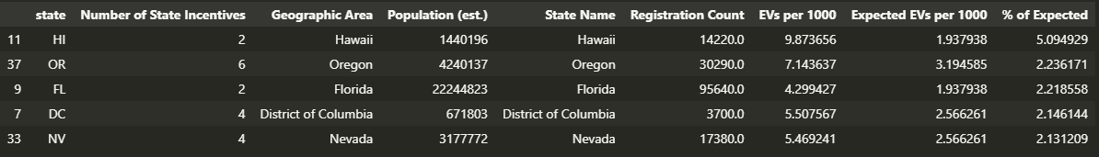
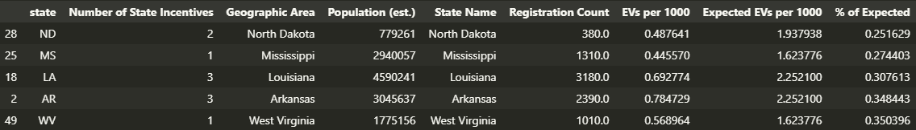

Slide 12
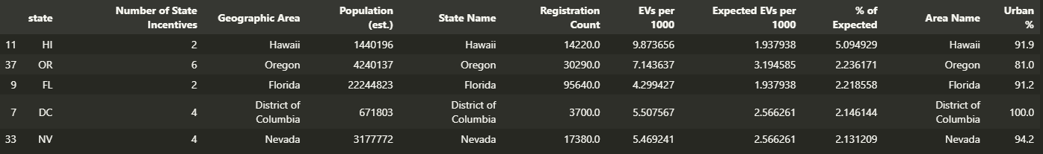
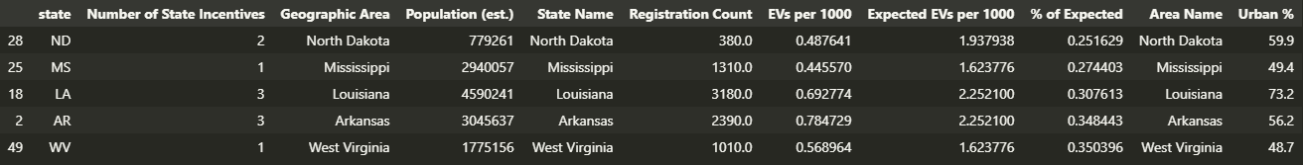

Slide 13
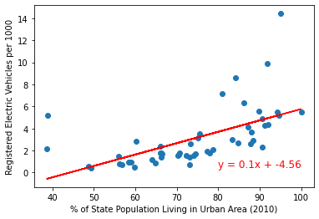
Registered EVs per Capita by % of State Population Living in Urban Area
r-squared: 0.33
Correlation between both factors: 0.58

Slide 14
Conclusions
Both the number of EV chargers and state incentives for purchasing show moderate correlation with the number of EVs registered in the state.
By using a regression model to identify the expected number of registered electric vehicles based on the number of available state incentives, we were able to identify a number of significant outlier states.
Further analysis identified that states overperforming expectations had a higher percentage of their population living in urban areas.
This indicates that, while the number of chargers and state incentives provide some insight, they are part of many different factors that go into whether or not consumers begin using EVs. Further exploration of factors influencing those decisions could provide additional insight into trends in EV adoption.

